Slide 1
Supporting LGBTI Students: Making the Student Mental Health Agreement LGBTI Inclusive
Student Mental Health Association
Rebecca Crowther, Ph.D.
Policy Coordinator
rebecca@equality-network.org

Slide 2
Notes:
Policy
Campaigns
Community development and engagement
The Equality Network works for lesbian, gay, bisexual, transgender and intersex (LGBTI) equality and human rights in Scotland. We strive to be inclusive and open in our work, to challenge discrimination and to consult, involve and inform the individuals and the communities for which we work.
The Equality Network was founded back in 1997 as a national organisation working for LGBT rights and equality in Scotland. We are a registered charity governed by a volunteer Board of Trustees.
Partnership is a key part of our approach, and much of what we do involves working in partnership with diverse LGBTI people, other LGBTI organisations, and with organisations working in the wider equality and human rights field.
Working with the Scottish Governments Mental Health directorate on the new transition and recovery plan delivery ensuring that it is equalities competent and considers LGBTI peoples experiences of mental ill health and the use of and access to services
We have also responded using our knowledge of the experiences of the LGBTI community to the Mental Health Law review and other related consultations regarding mental health law.
We work closely on policy areas relating to mental health alongside LGBT Health and Wellbeing and LGBT Youth as well as Stonewall Scotland.
We are also a member of the rural mental health forum, and work with the Scottish governments rural unit on issues related to isolation, access and mental wellbeing
We also have our own resources and research:
Supporting People resource: https://www.equality-network.org/resources/publications/community-engagement/supporting-people/
Rural LGBTI Mental Health: https://www.equality-network.org/lgbt-rural-report/
Additionally, my own PHD is in the field of wellbeing studies – we like to approach not only the experiences that lead to poor mental health but also the affects of poor mental health and the necessity to approach from a holistic wellbeing angle.
TWITTER: @LGBTIScotland @ScottishTrans @abonnieday
FACEBOOK: @EqualityNetwork @ScottishTrans.org
CONTACT US: rebecca@equality-network.org

Slide 3
Thank you to
Notes:
This resource …
With the support and collaboration of See Me/ See Me Proud and Support in Mind Scotland
The Equality Network supports the development and sustainability of LGBTI groups across Scotland and has done since 2001. We provide one-to-one support, develop leaders, deliver training and residential events; and publish resources focused on the priorities of groups.
We know from experience that LGBTI groups are often the first point of contact for those looking for support. While we as groups or individuals may want to help, we do not always have, or may not feel we have, the knowledge, training, and confidence to provide such support.
Signposting people to organisations with professional experience is one of the most important things we can do. We should do this wherever we feel out of our depth, or if we feel someone else may be better equipped to help. This should not prevent us from being able to listen and make space for others.
In this resource, Supporting People, we explore the theme of mental health, how it affects LGBTI people, and the techniques we can employ to talk to those living with mental ill-health.
FORMS A BASIS OF THIS WORKSHOP
This session will introduce key issues faced by the LGBTI community and how they lead to minority stress and in turn poor mental health and wellbeing.
It will look at important ways in which you can support LGBTI people or, as an LGBTI person, look after yourself, particularly if you are also looking out for others in your community. We will cover self-care, burnout, compassion fatigue and trauma informed approaches.
LGBTI people disproportionately suffer from poor mental health and wellbeing due in part to minority stress, prejudice and discrimination. We know that this has been exacerbated throughout the COVID 19 pandemic. We also know that LGBTI people need equalities competent support and that often they turn to others within the LGBTI community for this support as they do not find it elsewhere, this leads to burnout and compassion fatigue that further exacerbates poor mental health and wellbeing. The current backlash and toxic rhetoric around LGBTI rights makes this even harder. Often, conversations on campus, online and offline contribute to this climate.
While we as groups or individuals may want to help, we do not always have, or may not feel we have, the knowledge, training, and confidence to provide such support. Signposting people to organisations with professional experience is one of the most important things we can do.
[we will cover good places to signpost to at the end]
We should do this wherever we feel out of our depth, or if we feel someone else may be better equipped to help. However, this should not prevent us from being able to listen and make space for others.

Slide 4
MINORITY STRESS and poor mental health in the LGBTI community
Individual (self-stigma, disclosure)
Interpersonal (abuse, rejection, discrimination by others)
Societal (state policies, institutional practices)
Minority stress
Notes:
Understanding LGBTI Mental Health
Minority stress and wellbeing and mental health
External stressful events
Expectations of such events
Possible internalisation of negative societal attitudes
Concealment
Recognises that LGBT people’s experiences of ‘stigma, prejudice, and discrimination create a hostile and stressful social environment that causes mental health problems’
Poor mental health is not an intrinsic part of being LGBT.
THE SITUATION FOR LGBTI FOLK… (what we know)
LGB people are twice as likely to report symptoms of poor mental health than heterosexual adults
In the UK, LGB adults were around twice as likely to have attempted suicide in their lifetime
Trans people experience much higher rates of self-harm and suicide both in comparison to the general population and to the rest of the LGB community
88% of trans people showed symptoms of depression. 75% showed symptoms of anxiety (compared to 20% of people in the UK general population).
What does discrimination do for mental health? ASK

Slide 5
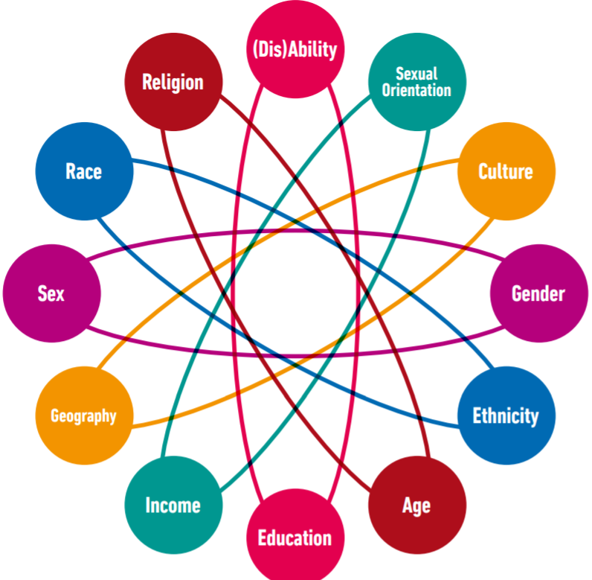
Notes:
It is also important to consider how multiple marginalisation affects people. When people experience intersectional discrimination (because of multiple aspects of their identity) this is different to experiencing minority stress due to only one aspect of identity (such as being LGBTI+). The above graphic shows how interlocking factors may cause minority stress and how these can reinforce one another, for example, experiencing particular discrimination because of being Muslim and gay because people assume you to be straight due to religious stereotypes…

Slide 6
A perfect storm for suffering with poor mental health…
An already existing disproportionate affect
+ Exacerbation due to COVID 19
+ Current backlash, toxic climate
+ poor equalities competence and lack of support
+ extensive waiting times for ALL services from GICs to Mental Health
+ rhetoric on campus
Notes:
And unfortunately this situation is only getting worse…
Exacerbation due to Covid 19
+ Current backlash, toxic climate and the effect on Mental health
AND poor equalities competence and lack of support (leading to turning to the community)
Often, conversations on campus, online and offline contribute to this climate.

Slide 7
BURNOUT AND COMPASSION FATIGUE
When we speak to others within the community who may be suffering,
we tend to take a little bit of that upon ourselves and carry it with us.
Notes:
Burnout and compassion fatigue within the community
With so many members of our LGBTI community experiencing poor mental health and wellbeing, and with many of us having poor experiences when accessing services for support, it is easy to see why we turn to each other instead. But when we speak to others who may be suffering, we tend to take a little bit of that upon ourselves and carry it with us. Carrying too much can damage our mental health, preventing us from being our best selves and being able or willing to support others. This is called compassion fatigue, and often affects caregivers ; but it can also affect those who support others in their day-to-day lives as friends. This is similar but slightly different to burnout which is normally specific to work cultures and practices whereas compassion fatigue is specific to caring for others who are experiencing trauma or emotionally challenging conditions.
The symptoms of compassion fatigue and burn out are similar and include: chronic physical and emotional exhaustion, irritability,
feelings of self-contempt, and difficulty sleeping. If you are feeling any of these things, speak to your GP and do not suffer alone.

Slide 8
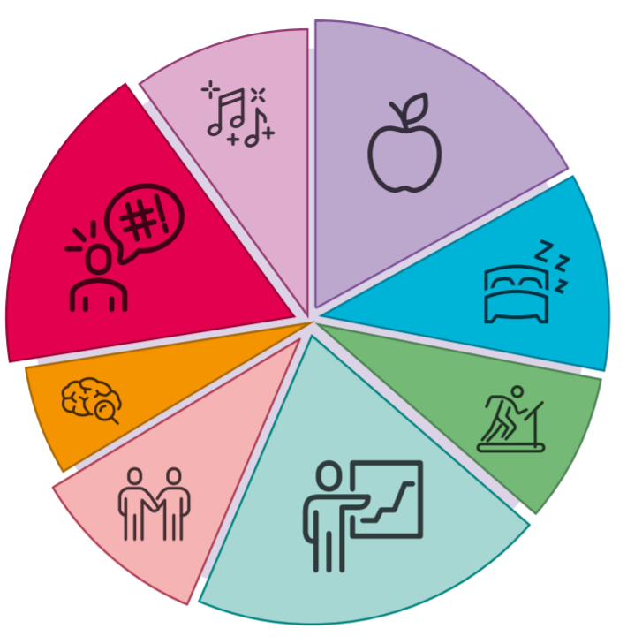
Self-care and boundaries
Notes:
Self-care and boundaries are both vital to our physical and mental health, but equally to that of others. When we don’t look after ourselves, then that is when we experience burnout and compassion fatigue. Boundaries are actually a form of self-care, knowing when we have reached our limit and we need to step away or take some time for ourselves, or even saying ‘no’ to some things is really important, and makes us more able to be there for people in the long-run. Often we are totally unaware that our boundaries have been crossed, or we are not used to setting any. Boundaries are both personal and professional and individual to each of us. They could relate to the amount or standard of work we expect ourselves to produce, what we allow others to know about ourselves, or they could be statements like: People may not... You might answer this with: “use me as a way to alleviate their anger or frustrations”, “gossip about others near me”. Try thinking about what boundaries are important to you and where you might need to ask for some.
Self-care simply refers to acts that you can do, for yourself, with intention, that help you to look out for your mental and/or physical health. Each person’s self-care practices are different. They are always good for your wellbeing and cannot be harmful to you. By this we mean, not everything that makes you feel good is self-care. Many things that we enjoy are not good for us at all and can cause serious problems to our mental health and wellbeing. So sometimes not doing the things you enjoy can be a practice of self-care too. Self-care can also include a bit of pampering, a walk or a swim, or even just making sure you have down-time with friends or with yourself – time when nothing is being asked of you. Try thinking about the activities that put you first, and always make you feel a little bit better.

Slide 9
Making the Student Mental Health Agreement LGBTI Inclusive
What should and could be done?
Image credit: Vonecia Carswell
Notes:
Trauma informed…
Safe, effective, empowering relationships are vital to enhancing resilience and recovery for those affected by trauma. Trauma can “impact on our connection to ourselves”. We can start to view things as our fault or feel we are deserving of bad things. It can also impact on outward connections, making us feel that we do not deserve these either, particularly if past relationships have been unhealthy or untrustworthy. Trauma is an important consideration when talking to anyone about their experiences, and in caring for yourself too. This is made worse if we experience inequality due to being LGBTI, such as health care inequalities, minority stress, or if these inequalities have contributed to our trauma in the first place.
Things that can be done to improve the support for LGBTI students…
Adopting and learning about ‘trauma informed practice’ can improve the support for LGBTI students, and for anyone who has experienced trauma. Trauma informed practice recognises why someone may adopt certain behaviours or have distrust towards others, to external connections or to public services. It sees these are coping mechanisms, and normal reactions to ‘abnormal circumstances’, focusing on ‘what has happened’ to a person, not “what is wrong” with that person. If you would like to learn more about this you can visit the NHS Trauma training programme which has a summary of their current online resources.
Could also encourage LGBTI students and external LGBTI organisations to contribute to the student mental health agreement…
Making the Student Mental Health Agreement LGBTI Inclusive …
DISCUSSION

Slide 10
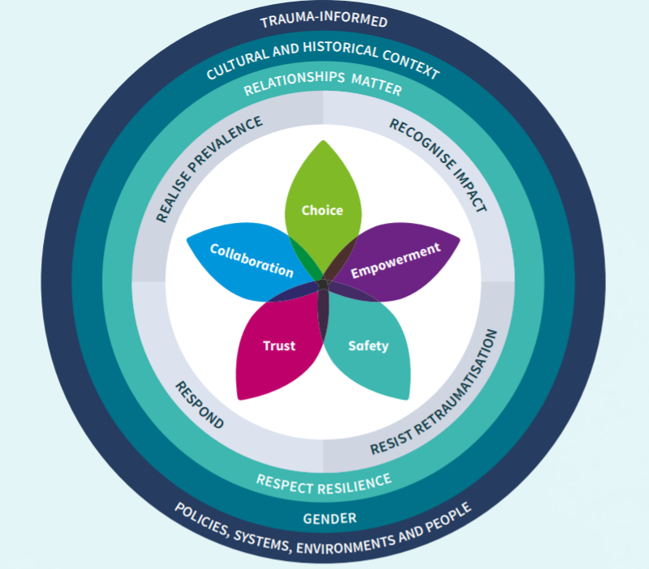
Notes:
NHS trauma online resource one with all the different aspects of trauma informed practice

Slide 11
Signposting
Notes:
Signposting
While we as groups or individuals may want to help, we do not always have, or may not feel we have, the knowledge, training, and confidence to provide such support. Signposting people to organisations with professional experience is one of the most important things we can do. We should do this wherever we feel out of our depth, or if we feel someone else may be better equipped to help. However, this should not prevent us from being able to listen and make space for others. There are lots of organisations in Scotland that you could reach out to including LGBT Youth or LGBT Helpline Scotland for specific LGBTI inclusive support, or SAMH for guidance on mental health.

Slide 12
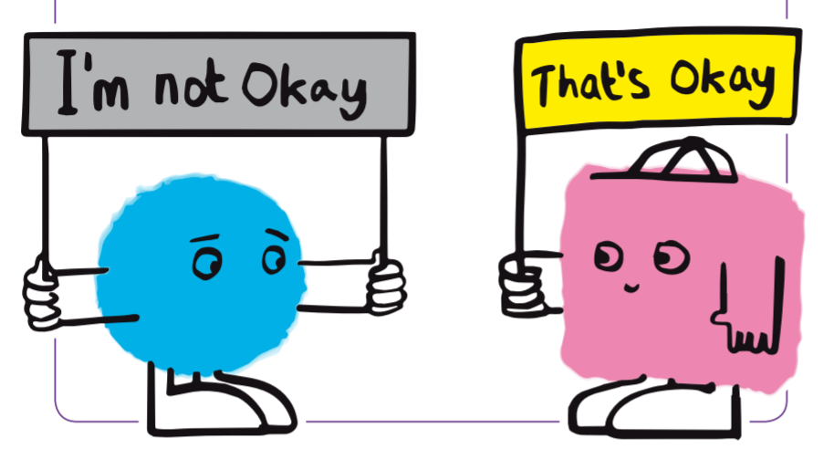
Notes:
And remember…
DISCUSSION AND SUMMARY

Slide 13
Dr Rebecca Crowther, Policy Coordinator, Equality Network
Rebecca@equality-network.org

