Slide 1
SMHA
Glasgow Clyde College Student Association

Slide 2
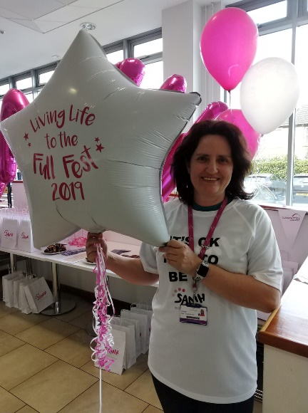
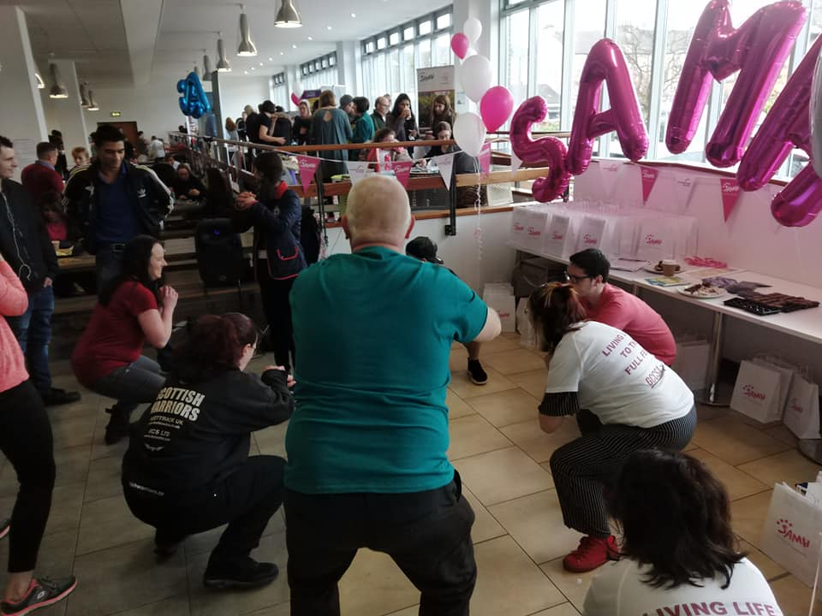
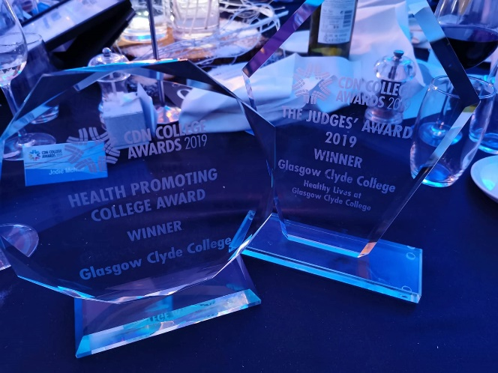
Background
Previous project with SAMH
Challenges faced
Gap left after this finished

Slide 3
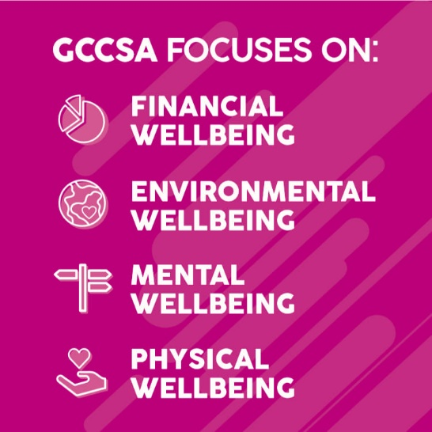
Where are we now?
Connecting in with Think Positive
Focusing on the long term
Working as part of wider network
The future…

Slide 4
Thanks for listening
GCCSA@GLASGOWCLYDE.AC.UK

