Slide 1
SMHA Info
Day 2022
#SMHAInfoDay22
Notes:
Opening remarks

Slide 2
Hello!
Katie Gilbert (she/her)
Think Positive Project Manager
Carly Baxter (she/her)
Administration and Communications
Coordinator
#SMHAInfoDay22

Slide 3
Housekeeping
Turn camera on if you’re comfortable to do so.
The event is being recorded.
Please mute your microphone when not speaking.
Feel free to use body signals to show you’re engaging: thumbs up, smiles, nods etc… but know that all of the group members might not always be able to see you.
If you require closed captions and can’t see them, please click the 3 dots>more>show subtitle and this will bring them up.
Use the chat box throughout to ask any questions.
If you’re having any tech issues, just it put in the chat.
PowerPoint presentations will be available afterwards.
Tag us in your social media! - #SMHAInfoDay22
#SMHAInfoDay22

Slide 4
Who we are
Think Positive – We help Scottish students’ associations and institutions to work together to develop and promote their mental health support offer. Create opportunities for project participants to learn from each others work - ThinkPositive@nus-scotland.org.uk
NUS Scotland - Campaign with our member students’ associations to improve the lives of students. We can provide advice on press, policy and campaigns – to support and amplify your local campaigns or raise your local issues at a national level. mail@nus-scotland.org.uk
NUS Charity - There to support your students’ associations development by providing several services including Quality Students' Unions framework, Elections Support Service, Governance Peer Review Scheme, Communities of Practices & HR support - uniondevelopment@nus.org.uk
#SMHAInfoDay22

Slide 5
Think Positive
Project Outcomes
Students’ associations, colleges and universities across Scotland will:
have a more joined up approach when supporting student’s mental health.
improve their mental health support offer.
be better equipped to support students' mental health.
#SMHAInfoDay22

Slide 6
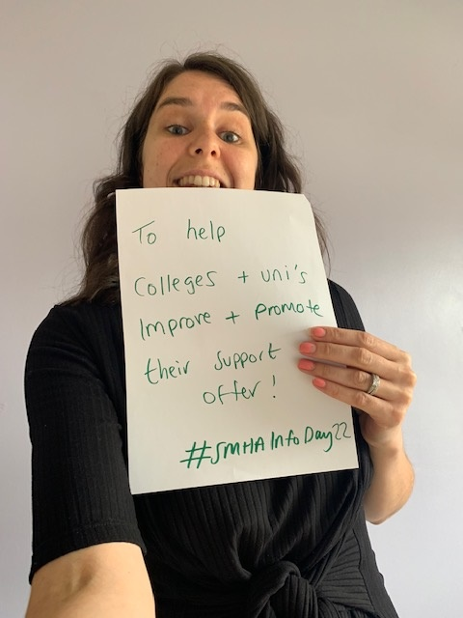
Question: What is your #1 mental health priority for the year ahead?
Instructions:
Grab paper & a thick pen that will be clear in a photo.
Answer the above question
Share a selfie of your aim on your social media, tag us @thinkposNUS & use the #SMHAInfoDay
Hold your picture up to your computer camera so we can take a group photo to share on our socials.
#SMHAInfoDay22

Slide 7
SMHA Overview & Project Updates
#SMHAInfoDay22

Slide 8
SMHA Overview
#SMHAInfoDay22

Slide 9
Student Mental Health Agreements
78% of all colleges, universities and students' associations in Scotland participate in creating their Student Mental Health Agreement.
The SMHA outlines how the whole institution will approach their student mental health and wellbeing work over a two-year period.
The content of each individual SMHA varies, however they all follow the same development steps including collaborating directly with students to shape the work.
Participants decide on their own working areas based on priorities, staff and student feedback, resources etc.. This project isn’t about creating lots of brand new workstreams, but promoting and improving what the support offer is.
#SMHAInfoDay22
Notes:
Pockets of great work. Whole institution approach.

Slide 10
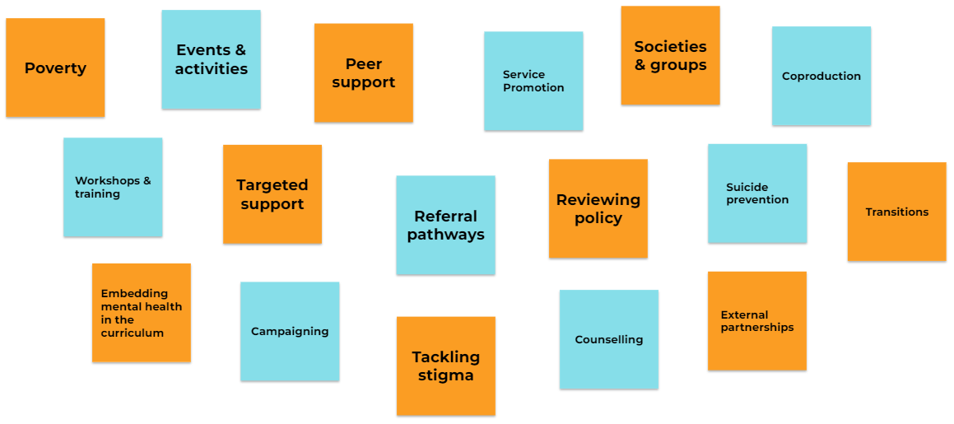
What is included in a SMHA?
#SMHAInfoDay22
Notes:
90% of students say the cost of living crisis is affecting their mental health NUS.

Slide 11
#SMHAInfoDay22

Slide 12
21-22 Project Participant reported benefits
Improved collaborative working between the institution & SA.
Student voice shapes what the support offer is.
Highlighted what is being done well and could be improved.
The institutions mental health support offer all being in one place.
Improved how activities are reviewed and evaluated.
Being able to share best practise with other colleges and universities.
The support and feedback from NUS.
Knowing what the whole support offer is for students.
Having a clear set of objectives to work towards with success measures.
Collaborative learning across the institution.
Focused institutional thinking and approach towards students mental health and wellbeing.
Gained better understanding of what students want.
Keeps mental health as a priority working area.
#SMHAInfoDay22

Slide 13
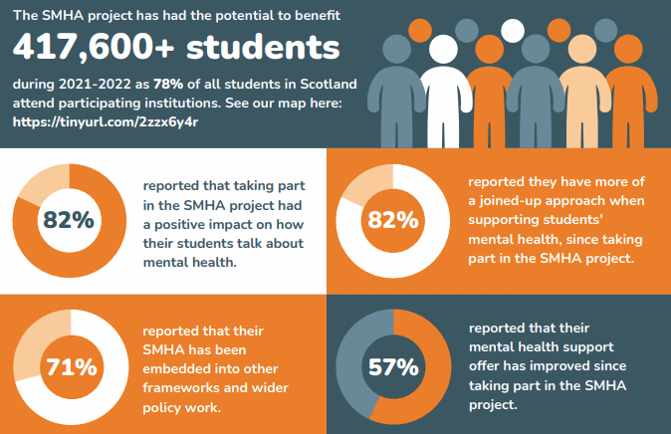
Project impact 2021-2022
#SMHAInfoDay22

Slide 14
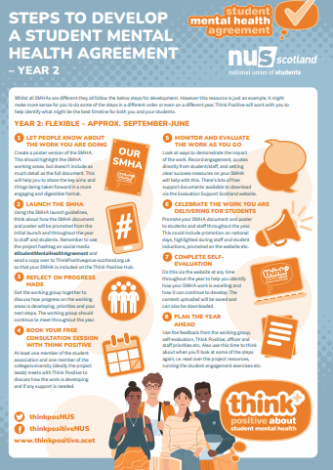
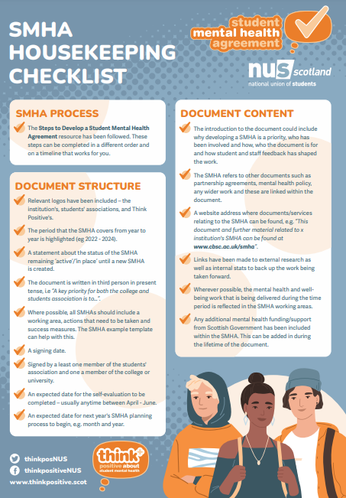
Project updates for 2022-2023
New project resources including project steps infographic, housekeeping guidance and support for international students.
A new student group will influence the direction of the project alongside the Project Advisory Group.
Think Positive Hub updates including institution page updates, uploading multiple files & self evaluation
National Student Mental Health Campaign
Developing our strategic goals
Working with the Scottish Government on a Student Mental Health Action Plan
A project consultant will be joining the team!
#SMHAInfoDay22

Slide 15
Updated support offer 2022-23
1-1 consultancy support throughout the year via video, email and telephone.
Access to SMHA participant area of The Think Positive Hub where all of the SMHA development resources can be found and 1:1 consultancy meetings are booked.
Be part of a Scotland-wide peer support network ‘The Forum’, where those leading on the project from across Scotland come together to discuss the opportunities and challenges they are facing.
Opportunity to apply for to the Small Grant Scheme, to help fund your SMHA activities (maximum £300).
Student coproduction workshops to help you to better collaborate with your students.
Online Self Evaluation to help you identify what is working well and what could be improved upon.
Participation certificate at the end of the project year.
All of the above support is completely FREE to you!
#SMHAInfoDay22

Slide 16
The Think Positive Hub
#SMHAInfoDay22

Slide 17
Think Positive Hub
The hub is for both students and those who support them.
Includes a summary of the mental health support offer at every college and university in Scotland.
All launched SMHA’s are saved on the institutions pages, for students, staff and the wider sector to access.
Next week you’ll receive a digital pack to help promote the Think Positive Hub with your students.
We want to use the hub to promote the fantastic work you’re doing.
www.thinkpositive.scot
(UCAS 2021)
#SMHAInfoDay22

Slide 18
SMHA Showcase
South Lanarkshire College
Mandy Murray
Depute Head of Student Services
#SMHAInfoDay22

Slide 19
Screen break!
See you in 15mins
#SMHAInfoDay22

Slide 20
SMHA Showcase
Glasgow Caledonian Univeristy
Rachel Simpson
Project Officer for Student Mental Health
#SMHAInfoDay22

Slide 21
A National Student Mental Health Campaign
Rosie McIntosh, Mind Waves
#SMHAInfoDay22

Slide 22
Key dates for your diary
1:1 Consultancy support sessions throughout the year
September - 6 month Think Positive Hub content review
4th, 10th, 13th & 25th October - Coproduction training
26th October – First The Forum meeting
TBC October – Self evaluation launches on the Think Positive Hub
23rd November – National Student Mental Health Campaign launches
1st December - Small Grant Scheme opens
16th January - Small Grant Scheme closes
March - 6 month Think Positive Hub content review
May – End of year survey
May-June – Self evaluations complete
#SMHAInfoDay22

Slide 23
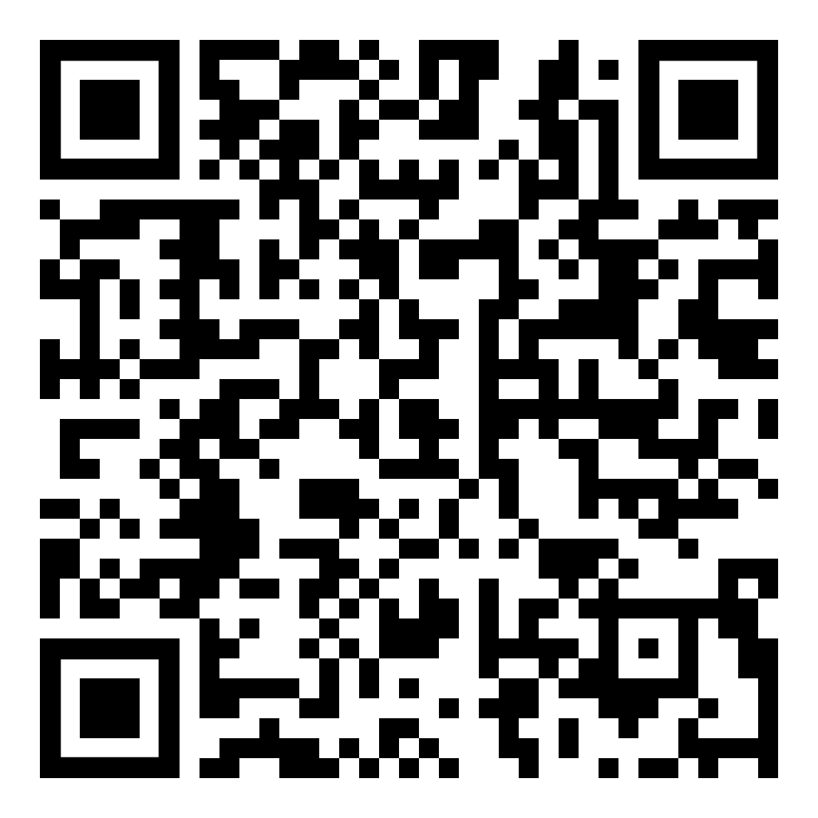
Feedback
Please take a couple of minutes to fill in this short survey – it’s only 6 questions!
We’ll use this to review the event against it’s objectives and improve it for next year.
#SMHAInfoDay22

Slide 24
4 Next Steps
Fill in your feedback form https://tinyurl.com/ds5fn462
2. Let us know who will be the SMHA project leads at your institution for 2022-23 by registering on the website https://tinyurl.com/uvysxyvk
3. Add Wednesday 26th October 10am-11.15am to your diary for the first ‘The Forum’ meeting.
4. Follow us:
Facebook: @thinkpositiveNUS
Twitter: @ThinkPosNUS
#StudentMentalHealthAgreement
www.thinkpositive.scot
for all project resources
#SMHAInfoDay22

Slide 25
Thank you!
#SMHAInfoDay22

