Slide 1
Trauma Informed Practice
Why, What & How this matters!
Angela Sheridan

Slide 2
WHY
Understanding trauma and neuro diversity through a biological lens, to helps illustrate why this is important - human informed!
WHAT
HOW
what trauma is and what we are already doing – provide an overview of the different phases completed thus far
How will we continue to support the development of practice to enhance our collective approach through developing Communities of Practice and a How-to Guide as lasting resources.
Conclusion
Questions & Answers
Our Values: OPEN & HONEST INNOVATIVE RESPECTFUL SUPPORTIVE

Slide 3

WHY?
Our Values: OPEN & HONEST INNOVATIVE RESPECTFUL SUPPORTIVE

Slide 4
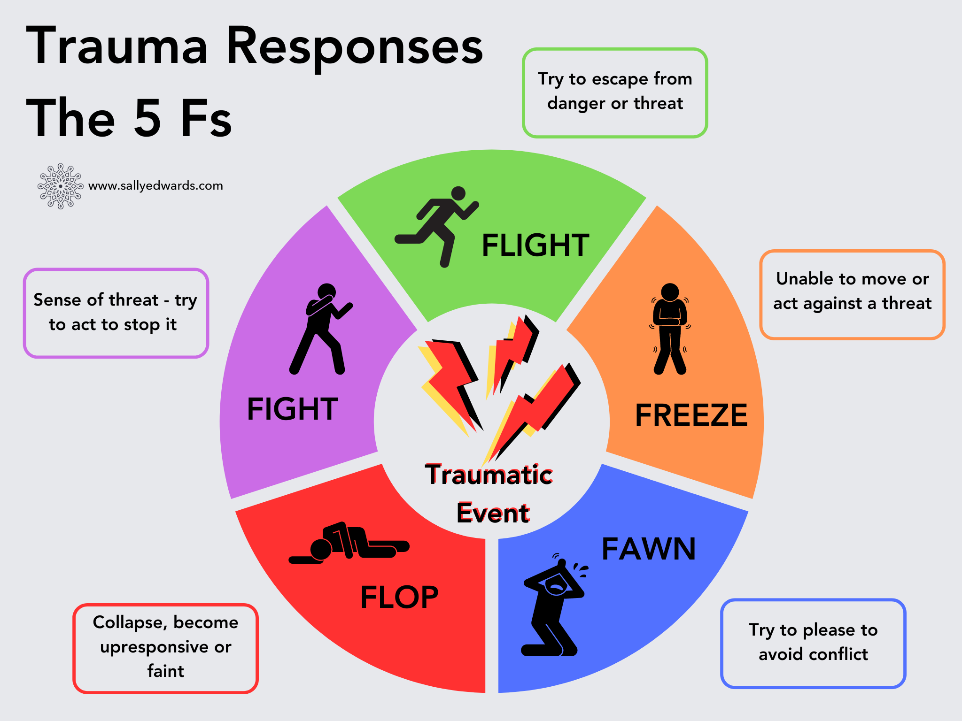

SENSORY OVERLOAD
Bright lights, loud noises, and crowded spaces can feel unbearable, yet your distress might have been dismissed as an overreaction.
SOCIAL EXCLUSION AND BULLYING
Many autistic people experience bullying or isolation, both as children and adults, leading to feelings of loneliness and rejection.
MEDICAL AND EDUCATIONAL TRAUMA
Schools and professionals may have focused on making you fit in rather than helping you thrive as you are.
BEING MISUNDERSTOOD
Others might have misinterpreted your emotions or struggles, leading to experiences of invalidation and frustration.
Fight or Flight
“unconscious and automatic series of fast-acting reactions occurring inside the body to help assemble resources the body needs to manage threatening circumstances”
Walter Cannon

Slide 5
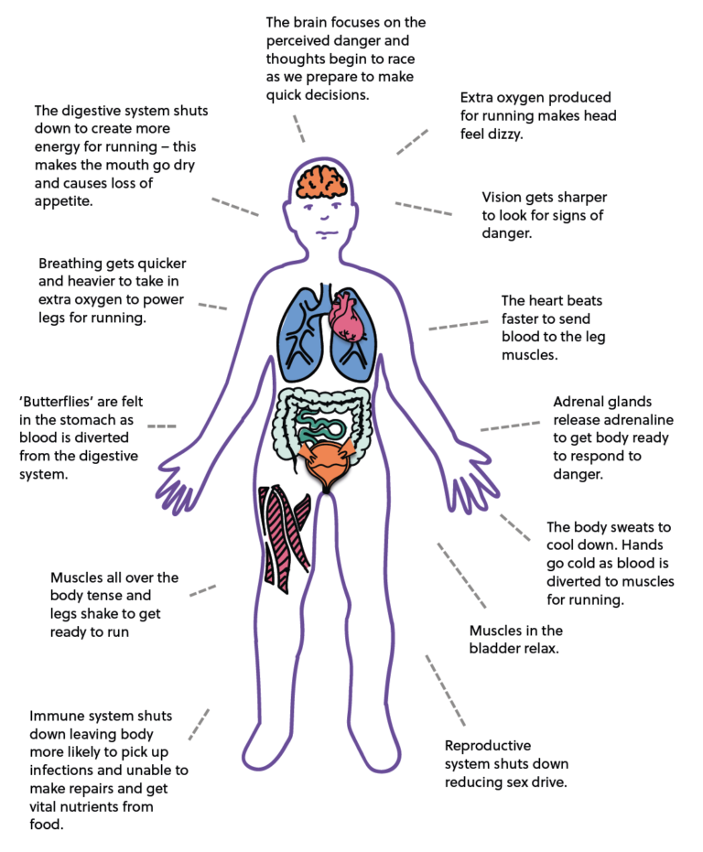
The impact on the body
When faced with a traumatic event, the brain activates its stress response system, consisting of the 5 Fs. This involves several biological processes resulting in a flood of stress hormones like cortisol and adrenaline.
These changes can affect emotional responses, concentration, and overall mental well-being.
Trauma can also reshape the delicate architecture of the brain, leaving a profound and lasting impact on mental health.

Slide 6
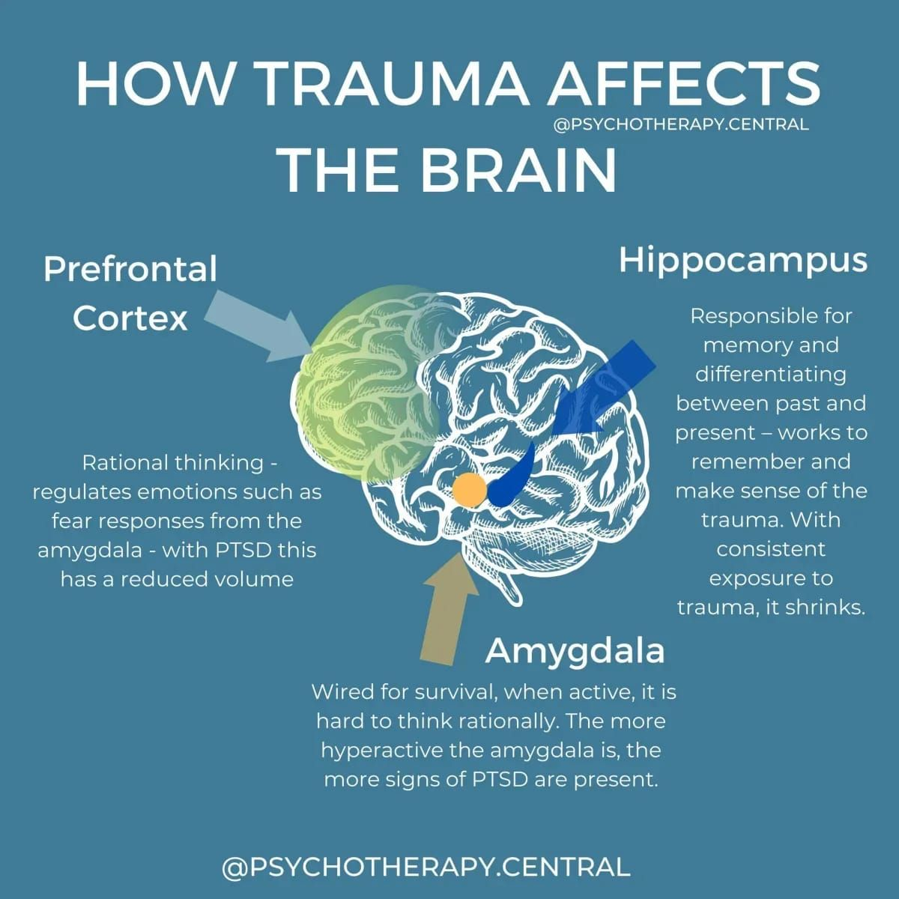
This is a simplified image explaining the impact of trauma on the brain, it literally causes brain damage.
The part of your brain used for function, learning, memory an emotion is called the hippocampus. With prolonged abuse i.e. trauma this part of the brain can shrink or development impaired (such as in child abuse).
With this part of the brain impaired, other more primal parts of the brain take over like the Amygdala. The primitive part of the brain that supports survival.

Slide 7
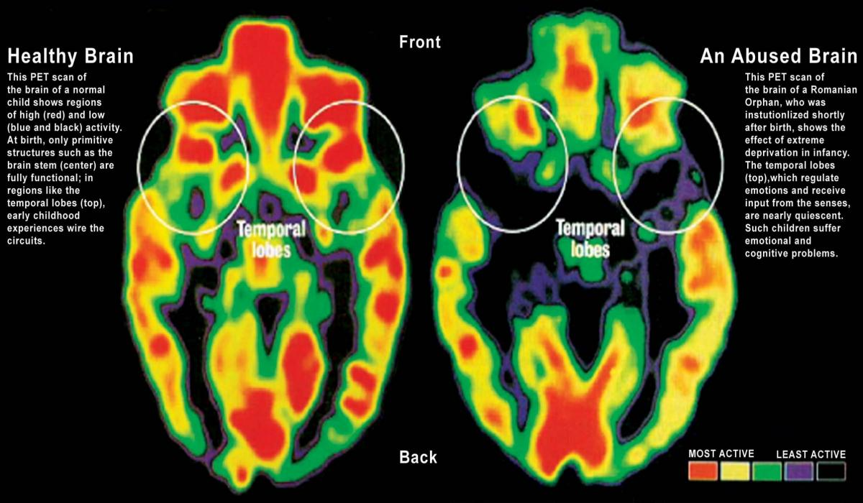
The impact of trauma on the brain
Trauma can cause lasting changes in the brain's structure and function.
The amygdala, hippocampus, and prefrontal cortex are particularly affected by trauma.
These changes can lead to mood disorders, anxiety disorders, and other mental health issues.

Slide 8
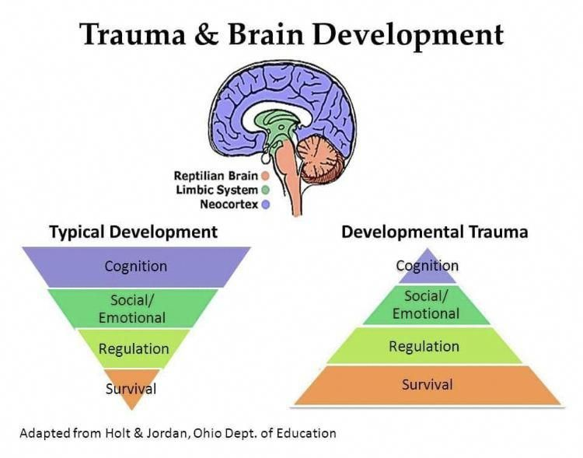

Slide 9
Regulate
Relate
Reason
Dr. Bruce Perry,
Trauma-informed approach and understanding about ACES-through training provided by Ayrshire College
All practice underpinned by three R's: Regulate, Relate then Reason.
The brain is organized to "act and feel before it thinks."
Build Predictable Routines within classes and making reasonable adjustments

Slide 10
WHAT?
Our Values: OPEN & HONEST INNOVATIVE RESPECTFUL SUPPORTIVE

Slide 11
Trauma is a deeply distressing or disturbing experience that can have lasting effects on a person's mental, emotional and physical well-being.
It can result from events like accidents, natural disasters, or personal loss but it can also be because of more persistent things such as abuse.
That's a very objective statement; however, trauma is very subjective, and trauma experience doesn't look the same for everyone!
Being a trauma informed organisation can support us to better support students who have trauma
What is trauma?

Slide 12
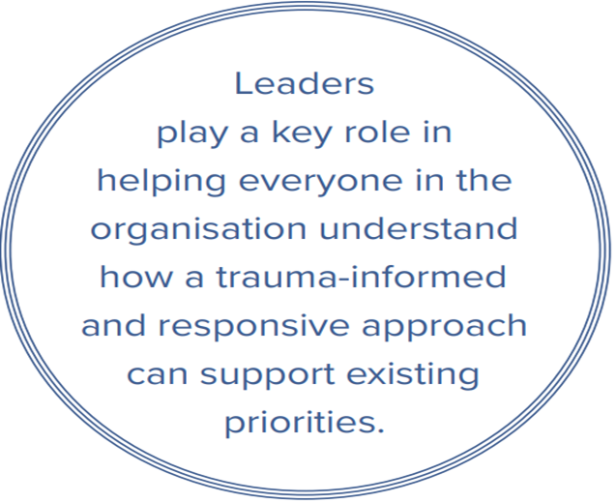
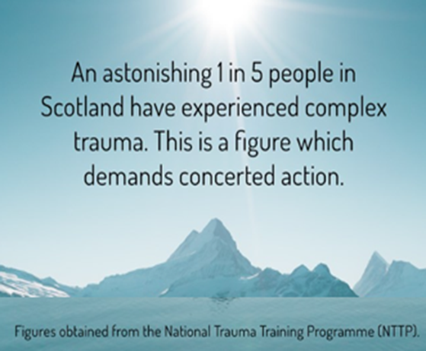
What is the College’s journey?

Slide 13
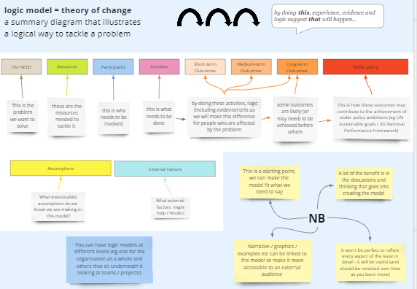
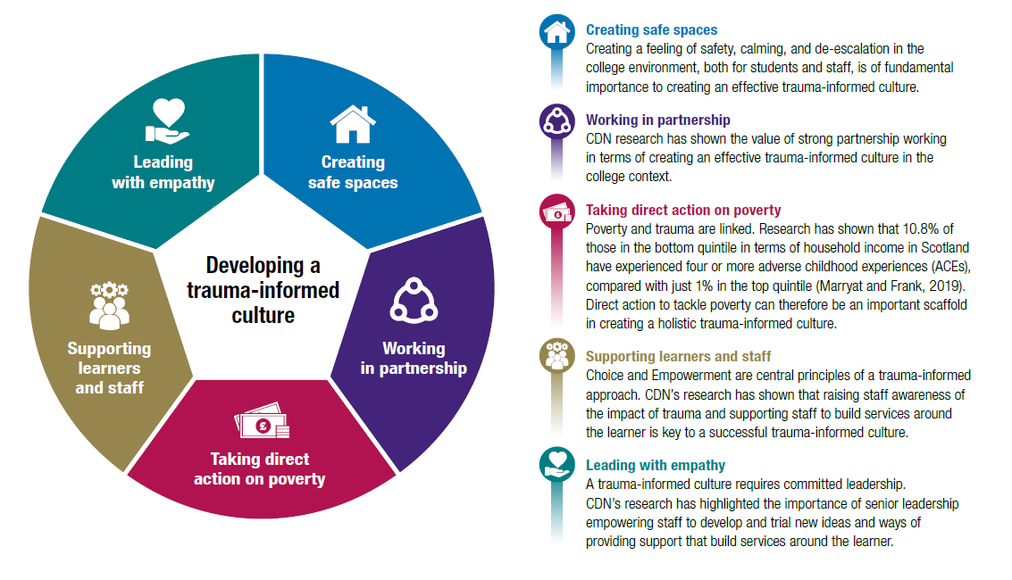

The Problem…
To address the inconsistent awareness, understanding, and acceptance of how trauma and/or adversity can affect individuals and organisations (staff, students, college), and how it can often impact educational outcomes, wellbeing, and culture, limiting a person and/or organisations ability to reach their full potential
The Need…
We are all human and organisations can be traumatized too, due to trauma and/or diversity deeply affecting human functioning, leaving many staff, students, and departments feeling disempowered
Potential Impact…
As TIR is not an add on, rather it aligns. integrates and cuts across many other internal and external agendas
e.g. Corporate Parenting, Equality Outcomes, Priority Student Groups
TIR will strengthen and support, cross cutting agendas and our staff, students, and departments will feel more empowered

Slide 14
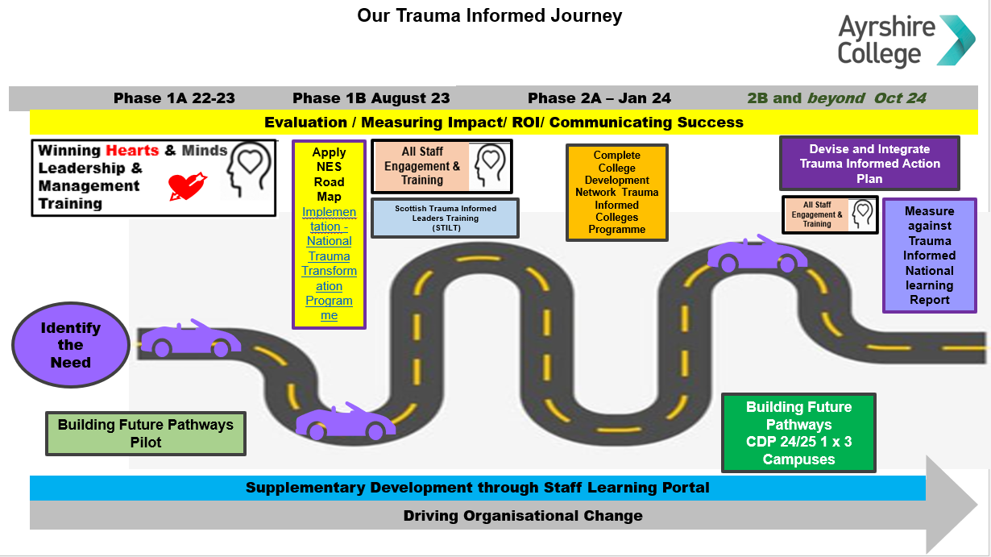
Short Medium Long-Term Roadmap

Slide 15
Phase 1A: Leaders & Managers 2022
85% Workshop Attendance Rate ​
70% Online E-Learning Completion
88% Rated Workshops Good or Excellent ​

Slide 16
Phase 1A: Students Pilot 22/23 CDP Course 24/25
The Changing Learner
Our Findings:
Wellbeing is intrinsic to learning and delivery
Getting to know learners is imperative
Staff Development is essential
Strength based goal setting approach is required
Flexibility & structure equally important
Consistent communication and collaboration between delivery team
CDN Report Impact of Covid:
Lower academic performance
delayed skills development
underdeveloped social skills
increased anxiety
decreased resilience
Improvement in digital literacy, has also led to challenges in maintaining attention and engagement
CDN Recommendations:
More nurturing approaches from educators
Effective Transition
Clearer Expectations
Consistent communication among partners
More comprehensive support
The CDN Training Programme: 4 Pillars
*Promoting Positive Behaviors and Resolving Conflict
*The Trauma Informed College
*Culture and Community
*Staff Wellbeing and Safeguarding
60% Building Future Pathways Pilot improvement in attendance
22/23
10% Early Withdrawal 10% Partial Success 60% Full Success
24/25 6% Early Withdrawal tbc % Partial Success 82% Potential Full Success

Slide 17
Phase 1B: Staff 22/23 & 24/25
282 staff have completed to date ( 40%)
Phase 1 A and Phase 1B combined completion 382 (47%)
135 were Curriculum Staff
73 were Student Support Staff
74 were Service Staff
1A:
"Sharing the case study information and asking what these young people need was vital to spend time on. We got to share our thoughts with others in the room and I think this was a pivotal part of the training"
1B:
" I am familiar with these behaviors but would appreciate more training"
"It needs to be a whole College approach, and we need consistent strategies that are relevant to Learning and Teaching"

Slide 18
Phase 2A
Phase 2A: January 2024
75 Kilmarnock
58 Ayr
45 Kilwinning
CDN Diagnostic Workshops
Areas attending: HBCM, MSPPA, ADM, Sports, HSC, EY, Supported Learning Hive, Student Experience
178 total 37 People provided fed back = 40% evaluation rate

Slide 19
Phase 2B: Between Oct 2024 & March 2025 …and Beyond
Leadership and Management
Supporting Learners and Staff
Collaborative Partnerships
Physical & Emotional Environments
Consistent Communication
Policies, Procedures, and Practice
Knowledge and Skills
Foster empathy, compassion, and psychological safety in leadership. Prioritise relationships and understanding trauma across the whole organisation, ensuring every individual's experience is valued.
Promote wellbeing as central to learning, providing choices and fostering parity among staff and students. Listen to those with lived trauma experiences, offering support that acknowledges personal and organisational wellbeing, such as supervision and reflective practices.
Enhance collaboration across departments and external partners, focusing on trauma awareness. Strengthen partnerships to use education as a path to recovery.
Evaluate and improve recruitment processes and campus spaces to create nurturing, trauma-sensitive environments. Reduce environmental stressors (e.g. improve signage) and raise staff awareness of trauma-informed environment practices.
Create clear, trauma-informed communication resources, and adapt language to prevent trauma triggers. Establish feedback loops, align with existing action plans, and ensure TIR principles are visible throughout the staff and student journey.
Ensure policies, are trauma informed. Integrate trauma-informed principles into policies (e.g., conduct, recruitment, withdrawal, assessment, safeguarding and wellbeing ).
Provide ongoing training in trauma-informed practice for staff, building empowerment through CPD. Educate staff and students on basic neuroscience psychology and physiology to better understand trauma.

Slide 20
HOW?
Our Values: OPEN & HONEST INNOVATIVE RESPECTFUL SUPPORTIVE

Slide 21


Learning, Teaching & Quality Steering Group
Creating Communities of Practice (CoPs)
LTA
CoP
Oversight and governance from Learning, Teaching & Quality Steering Group
Support provided from Learning & Teaching Academy
Ideas for a CoP can come from any staff member or may be put forward by the LTQSG
New CoP ideas will be considered by LTQSG for approval
Once an idea is approved the CoP can be established
Staff made aware of new CoP and those who wish to can join
CoP will now decide the direction and work to be undertaken
Progress fed back to LTQSG and all staff updated via the CoP Viva page
Idea
Staff Join
Direction Set
Work Begins
Approval
Set-up
Viva page set-up to provide all staff news and updates
Teams page set-up as CoP working group / community

Slide 22
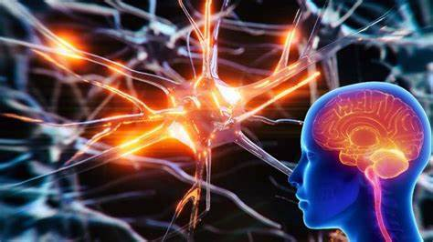
The good news
Neuroplasticity: The Brain’s Superpower for Healing
Neuroplasticity is the brain’s ability to reorganise itself by forming new neural connections throughout life. It’s like having a team of expert city planners constantly working to improve and adapt the city’s infrastructure.
This remarkable process allows the brain to rewire itself, creating new pathways and strengthening existing ones. It’s the reason why stroke patients can sometimes regain lost functions and why we can learn new skills at any age.

Slide 23

Thanks and
Now time for questions

